Slide 1


END SEMESTER PROJECT PHASE I- REVIEW
Project Title: MindBridge- A Multimodal AI Framework for Mental Health Risk Prediction and Personalized Wellness Intervention
Batch Number: AIML B20
Guide Name: Ms. Derisha Mahil
Team Members: Vaishnavi B (REGISTER NO)
Vijayalakshmi G (REGISTER NO)
DD – MM - YYYY

Slide 2
Abstract
MindBridge: Multimodal Mental Health Prediction Using NLP and Speech Emotion Recognition
Mental health issues — including depression, anxiety, academic stress, and social loneliness — silently affect millions of students, working adults, and senior citizens. Most existing systems rely on single-channel text analysis and treat all users identically, missing the distinct emotional needs of each life stage.
MindBridge addresses this gap by combining two AI pipelines: a Natural Language Processing (NLP) channel using MentalBERT for text emotion analysis, and a Speech Emotion Recognition (SER) channel using CNN trained on RAVDESS for voice tone analysis. Both scores are fused using a weighted ensemble (55% text + 45% voice) to produce a single wellness index.
The system first identifies the user as a Student, Adult, or Senior Citizen and routes the prediction through a persona-specific model. Output includes a severity level (no-risk / mild / moderate / severe), LIME word-level explainability, and 3 daily wellness activity recommendations — demonstrated through an interactive Streamlit prototype.
24 – 08 - 2026

Slide 3
Motivation
Why This Problem Matters
Students: Exam stress, burnout, peer pressure — warning signs are invisible until a breakdown
Adults: Career anxiety, relationship breakdowns, financial pressure — masked behind a composed exterior
Senior Citizens: Post-retirement loneliness, empty nest syndrome — no platform to express emotional distress
Why Existing Approaches Fall Short
Text-only models miss what voice reveals — a person can type 'I am fine' while sounding flat and hopeless
No system segments prediction by life stage — a stressed student needs different support than a lonely retired person
Generic outputs do not translate into actionable daily guidance for recovery
MindBridge is motivated by the need for an early, multimodal, and human-centered mental wellness detection system.
24 – 08 - 2026

Slide 4
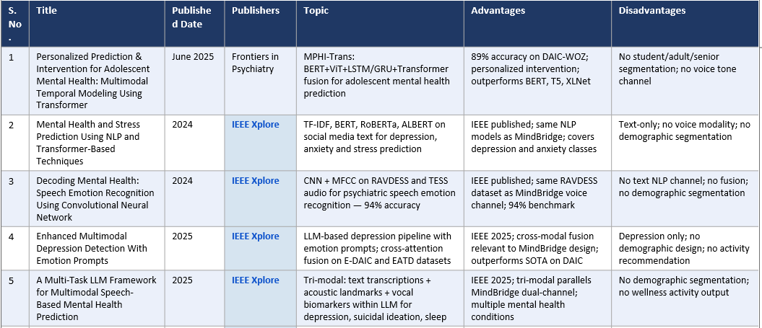
Literature Survey
24 – 08 - 2026

Slide 5
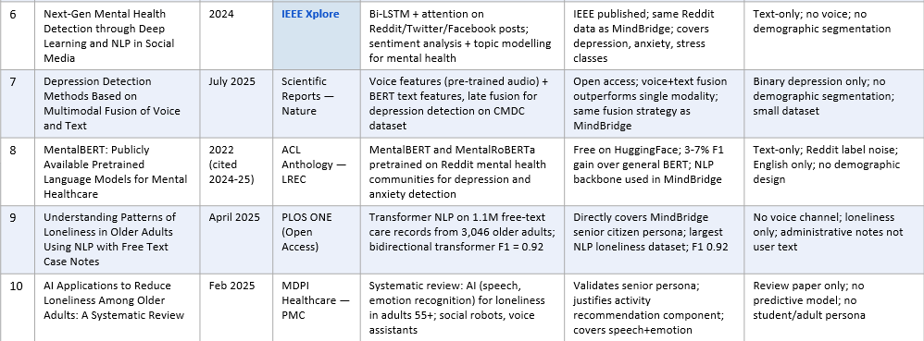
Literature Survey
24 – 08 - 2026

Slide 6
Disadvantages of Existing System
Single Modality — Text Only
Existing systems like MentalBERT and Reddit-based classifiers rely solely on typed text. They cannot detect emotional tone hidden in voice — pitch, energy, speech rate — which are clinically proven mental health indicators.
No Demographic Awareness
Systems like MPHI-Trans (Zhang & Li, 2025) target only adolescents. No system segments users into students, adults, and senior citizens with separate trained models and persona-specific outputs.
Classification Without Intervention
Existing models output a label (depressed / not depressed) but provide no actionable next step — no daily activities, no recovery guidance, no tailored recommendations.
No Explainability
Most systems are black boxes — clinicians and users cannot see why a prediction was made. Without explainability (LIME / SHAP), predictions are not trusted or actionable.
No Fusion of Text and Voice
Voice disagrees with text in real distress — none of the reviewed papers combine NLP text scores and speech emotion scores into a weighted fusion for mental health specifically.
24 – 08 - 2026

Slide 7
Proposed System
MindBridge — A Multimodal, Demographic-Aware Mental Wellness Agent
Dual Input
User types a message OR speaks into a microphone — both inputs are accepted simultaneously
Persona Detection
System identifies the user as Student, Adult, or Senior Citizen and routes to a persona-specific model
Text Channel
MentalBERT fine-tuned on Reddit Mental Health Dataset — detects depression, anxiety, stress from written text
Voice Channel
1D CNN trained on RAVDESS audio dataset — extracts MFCC, pitch, energy, speech rate for tone analysis
Weighted Fusion
Text score (55%) + Voice score (45%) combined into a Wellness Index 0–100 with severity classification
Output
Severity level + LIME word highlights + 3 persona-specific daily wellness activities — shown in Streamlit demo
24 – 08 - 2026

Slide 8
Goal
Primary Goal
To build a working prototype that detects mental health risk from both typed text and spoken voice, segments the prediction by demographic persona, and delivers actionable wellness recommendations — all demonstrated live to external examiners.
Specific Objectives
Train MentalBERT NLP model on Reddit Mental Health Dataset — target accuracy: 88%+
Train CNN Speech Emotion Recognition model on RAVDESS and CREMA-D — target accuracy: 80%+
Build weighted fusion engine combining text and voice scores into a single wellness index
Implement persona classifier routing Student / Adult / Senior to separate prediction models
Generate persona-specific daily activity recommendations per severity level
Add LIME explainability to highlight words that influenced each prediction
Deploy interactive Streamlit demo that runs offline on a single laptop for viva presentation
Success Metric: Examiner can interact live with the system — type or speak — and see a meaningful, explainable wellness output within 3 seconds.
24 – 08 - 2026

Slide 9
Architectural Diagram
System Overview — 5-Layer Pipeline
Layer 1 — Input: User types text OR speaks into microphone
Layer 2 — Preprocessing: Text → clean → tokenise (BertTokenizer) | Voice → Whisper transcription → librosa MFCC/pitch/energy extraction
Layer 3 — Persona Detection: Classify user as Student / Adult / Senior → route to persona-specific model
Layer 4 — Dual AI Models: NLP Channel: MentalBERT → text emotion score | SER Channel: 1D CNN → voice tone score
Layer 5 — Fusion Engine: Weighted ensemble (55% text + 45% voice) → Wellness Score 0–100 → Severity: No-risk / Mild / Moderate / Severe
Layer 6 — Output: Severity label + LIME word highlights + 3 daily activities + Streamlit dashboard
Key Design Insight
Voice catches what text hides — 'I am fine' typed vs spoken in a flat, slow, emotionless tone gives different scores. Fusion of both is more accurate than either alone.
24 – 08 - 2026

Slide 10
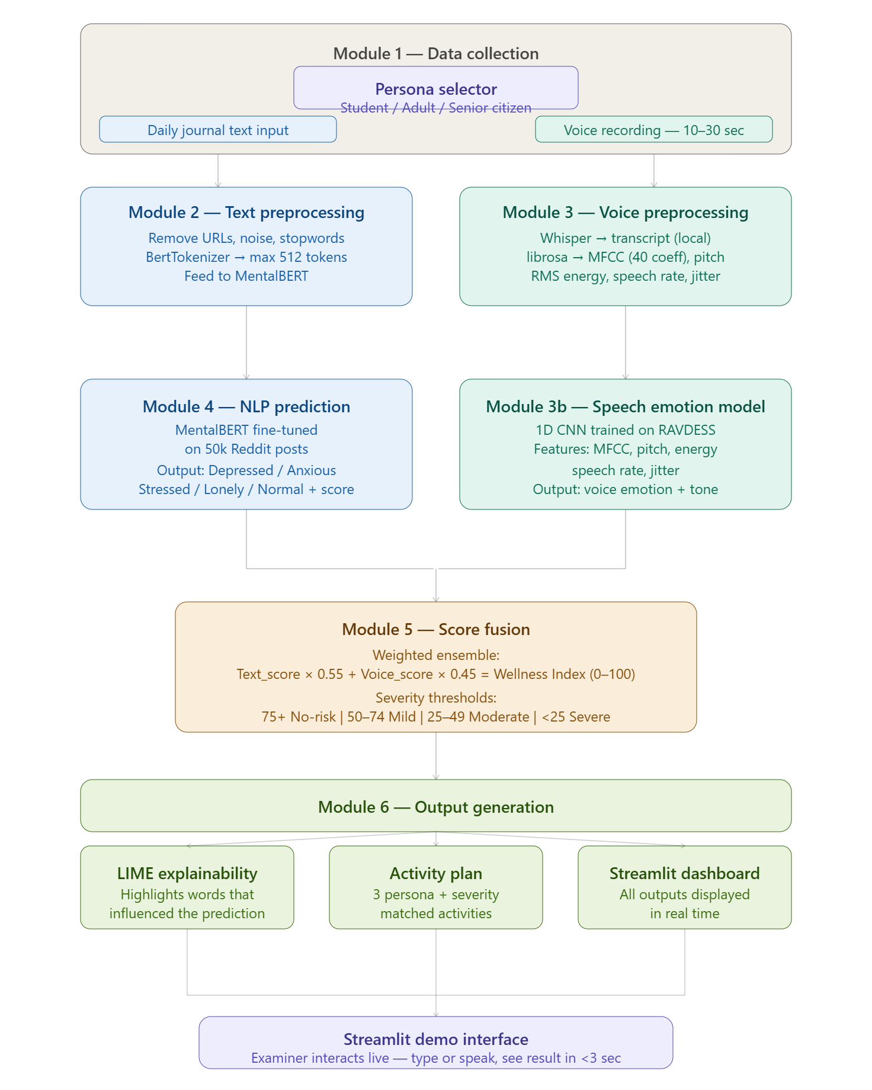
24 – 08 - 2026

Slide 11
Modules — Explanation of Architectural Diagram
Module 1 — Data Collection
Onboarding: user selects persona. Inputs daily journal text or 10–30 sec voice recording.
Module 2 — Text Preprocessing
Remove URLs, noise, stopwords → tokenise using BertTokenizer → max 512 tokens → feed to MentalBERT.
Module 3 — Voice Preprocessing
Whisper (local) converts speech to text → librosa extracts MFCC (40 coefficients), pitch (Hz), RMS energy, speech rate, jitter → 1D CNN classifies emotion.
Module 4 — NLP Prediction
MentalBERT fine-tuned on 50k Reddit posts → outputs: Depressed / Anxious / Stressed / Lonely / Normal with confidence score.
Module 5 — Score Fusion
Weighted ensemble: Text_score × 0.55 + Voice_score × 0.45 = Wellness Index (0–100). Severity thresholds: 75+ = No-risk, 50–74 = Mild, 25–49 = Moderate, <25 = Severe.
Module 6 — Output Generation
LIME highlights key words → 3 persona+severity matched activities fetched from activity library → displayed on Streamlit dashboard in real time.
24 – 08 - 2026

Slide 12
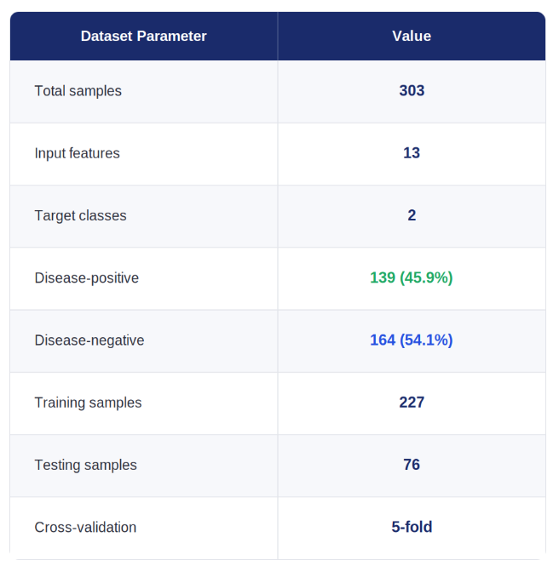
DATASET STATISTICS
• The dataset contains 303 patient records with 13 clinical attributes.
• The target classes consist of 139 disease-positive and 164 disease-negative cases.
• The dataset exhibits a relatively balanced class distribution.
• A stratified 75:25 split is applied for training and testing.
Five-fold cross-validation is used for model evaluation.
.

Slide 13
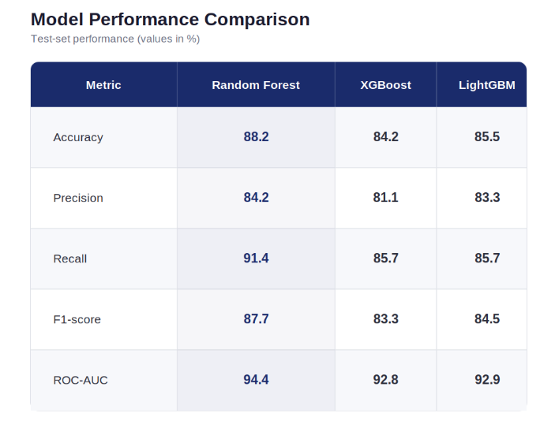
MODEL EVALUATION
• Three ensemble learning algorithms were evaluated: Random Forest, XGBoost, and LightGBM.
• All models were trained using 300 estimators with optimized hyperparameters.
• Five-fold stratified cross-validation was employed to assess model stability.
• Performance was evaluated using accuracy, precision, recall, F1-score, and ROC-AUC.
• Random Forest achieved an ROC-AUC of 0.944 and an accuracy of 88.2%.
• Cross-validation was used to examine performance consistency across different data partitions.

Slide 14
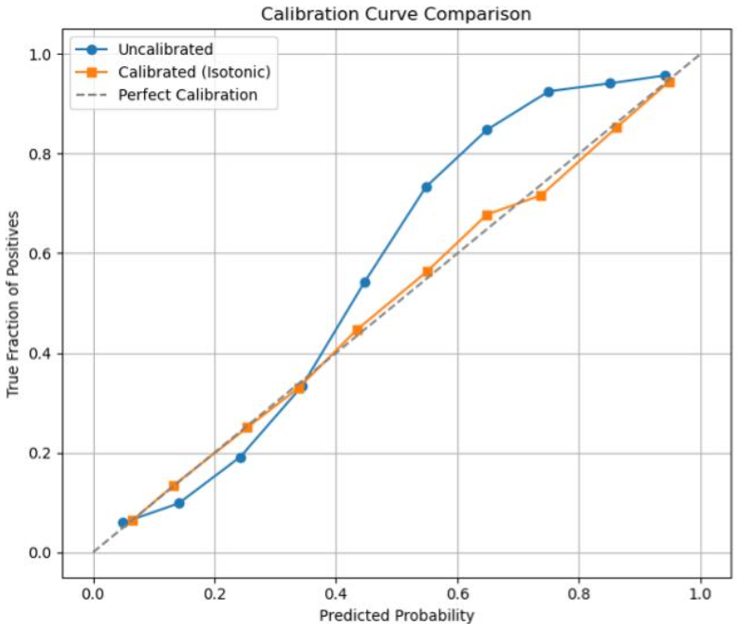
CONFIDENCE CALIBRATION AND EXPLAINABILITY
• Probability Calibration: Isotonic regression is used to calibrate the predicted probabilities.
• Reliable Risk Estimation: Improves the reliability of predicted heart disease risk probabilities.
• Global Explainability: SHAP identifies the most influential clinical features in the model.
• Local Explainability: SHAP explains individual predictions by showing how clinical features contribute to the output.
• Transparent Predictions: Helps users understand the factors influencing the model's risk predictions.

Slide 15
WHY RANDOM FOREST?
• Suitable for Tabular Data: Effectively handles structured clinical data from the Cleveland Heart Disease dataset.
• Captures Nonlinear Relationships: Identifies complex interactions among clinical attributes.
• Ensemble Learning: Combines multiple decision trees to improve prediction robustness.
• Reduced Overfitting: Uses bootstrap sampling and random feature selection to reduce variance.
• Comparative Performance: Achieved an ROC-AUC of 0.944, compared with 0.928 for XGBoost and 0.929 for LightGBM.
• Explainability: Supports SHAP-based global and patient-specific explanations.

Slide 16
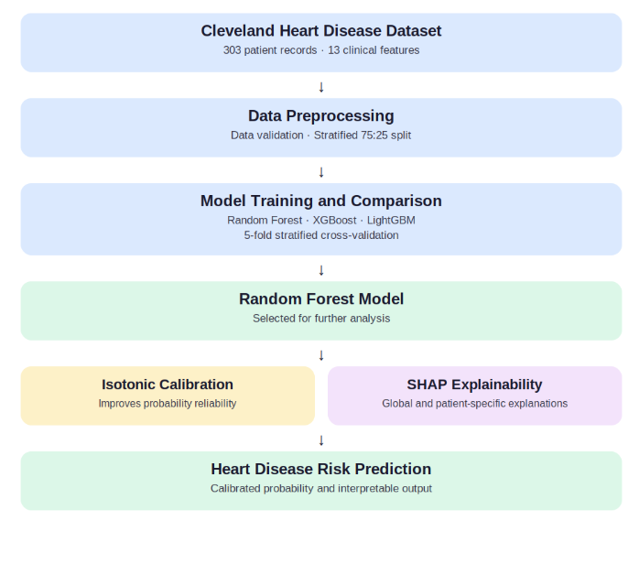
CardioShield Architecture Overview
• Input: 13 clinical features from the Cleveland dataset.
• Model selection: Random Forest, XGBoost, and LightGBM are compared.
• Calibration: Isotonic regression improves probability reliability.
• Interpretability: SHAP explains feature contributions to predictions.
• Output: Calibrated heart disease risk probability with explanations.
.

Slide 17
Architecture Flow
1.Dataset Collection: Cleveland Heart Disease Dataset
2.Data Preprocessing: Handle data and prepare clinical features
3.Data Splitting: Stratified 75:25 train-test split
4.Model Training: Random Forest, XGBoost, and LightGBM
5.Model Evaluation: 5-fold stratified cross-validation
6.Model Selection: Random Forest based on performance (AUC: 0.944)
7.Confidence Calibration: Isotonic regression to improve probability reliability
8.Explainability: SHAP for global feature importance and individual predictions
9.Final Output: Heart disease risk prediction with confidence-aware probabilities and explanations

Slide 18
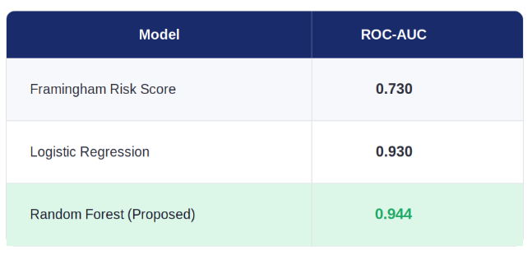
Baseline Comparison
• Framingham Risk Score (FRS): Traditional clinical risk assessment method.
• Logistic Regression: Task-matched machine learning baseline.
• Random Forest: Proposed model for nonlinear clinical patterns.
• ROC-AUC Comparison:
  Framingham Risk Score: 0.730
  Logistic Regression: 0.930
  Random Forest: 0.944
• Key Observation: Random Forest achieved the highest ROC-AUC among the compared methods.

Slide 19
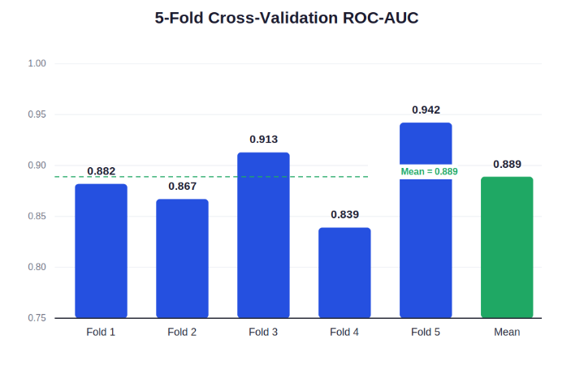
Training Dynamics – 5-Fold Cross-Validation
• 5-fold stratified cross-validation was used to evaluate model stability.
• Random Forest achieved consistent ROC-AUC across all five folds.
• Fold-wise ROC-AUC: 0.882, 0.867, 0.913, 0.839, 0.942
• Mean ROC-AUC: 0.888
• Standard deviation: ±0.036
• No fold scored below 0.83, indicating stable performance across different data partitions.

Slide 20
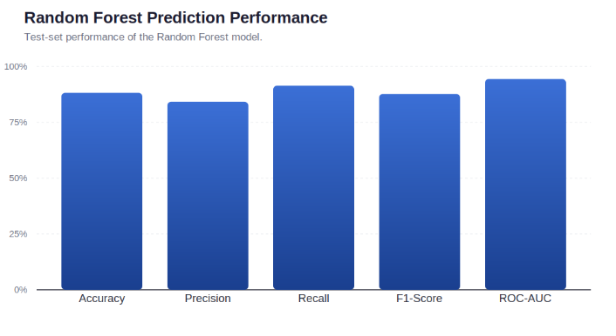
Prediction Accuracy
• Random Forest achieved the highest test accuracy of 88.2%.
• Precision: 84.2%
• Recall (Sensitivity): 91.4%
• F1-Score: 87.7%
• ROC-AUC: 94.4%
• The model showed strong ability to correctly identify patients with heart disease while maintaining balanced overall performance.

Slide 21
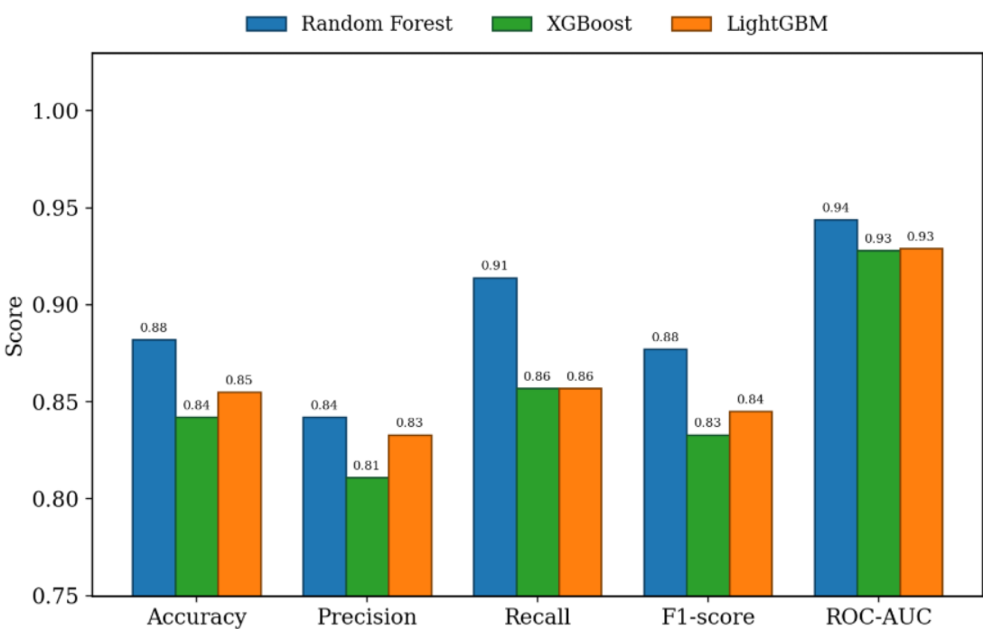
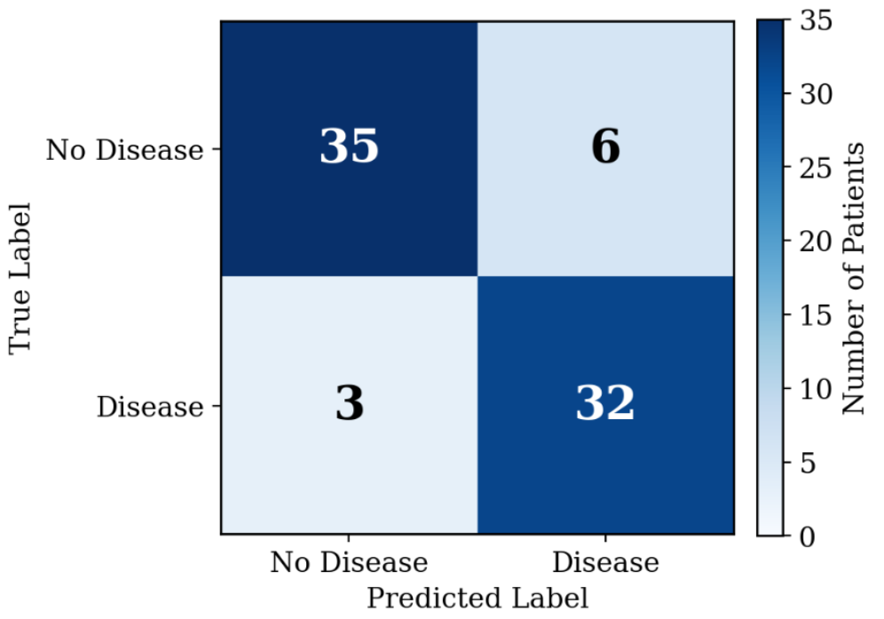
Graph Insights
• Figure 2 presents the comparative performance of Random Forest, XGBoost, and LightGBM across five evaluation metrics.
• Random Forest shows the strongest overall performance, particularly in ROC-AUC (0.944) and Recall (0.914).
• Figure 3 presents the 5-fold cross-validation performance of Random Forest, with a mean ROC-AUC of 0.888 ± 0.036.
• The consistent fold-wise scores, with no fold below 0.83, indicate stable model performance across different data partitions.
• Figure 4 compares the ROC curves of Random Forest and the Framingham Risk Score; the higher Random Forest curve demonstrates stronger discriminative capability (AUC 0.944 vs. 0.730).
• Figure 5 shows the confusion matrix, where Random Forest correctly identifies 32 of 35 disease-positive cases, resulting in 91.4% recall.

Slide 22
Discussion
• Random Forest achieved the best overall performance, with an ROC-AUC of 0.944 and accuracy of 88.2%, outperforming XGBoost and LightGBM.
• Its recall of 91.4% detected 32 of 35 disease-positive cases, with only 3 false negatives, which is important for screening applications.
• 5-fold cross-validation showed stable performance, with a mean ROC-AUC of 0.888 ± 0.036 and no fold below 0.83.
• SHAP analysis identified major vessel count, chest pain type, and thalassemia status as the most influential predictors, improving model interpretability.
• External validation showed lower performance across other datasets (AUC 0.875–0.721), highlighting the need for broader clinical validation across different populations and institutions.

Slide 23
Conclusion
• Random Forest achieved the highest predictive performance with 88.2% accuracy and 0.944 ROC-AUC.
The model achieved 91.4% recall, detecting 32 of 35 disease-positive cases.
• SHAP analysis identified major vessel count, chest pain type, and thalassemia status as key predictors.
• Isotonic calibration improved the Brier score from 0.101 to 0.093, improving probability reliability.
• External validation showed reduced performance, demonstrating the need for broader validation across clinical datasets.

Slide 24
Future Work
•Validate the model on larger, more diverse patient cohorts to improve generalizability.
• Perform site-specific recalibration to address performance differences across hospitals and datasets.
• Conduct subgroup fairness analysis to ensure consistent performance across diverse populations.
• Expand SHAP-based interpretability to strengthen clinician trust and transparency.
• Develop a clinically actionable deployment framework for supporting medical decision-making.

Slide 25
Thank You !!!

Slide 26
Queries?

